Slide 1
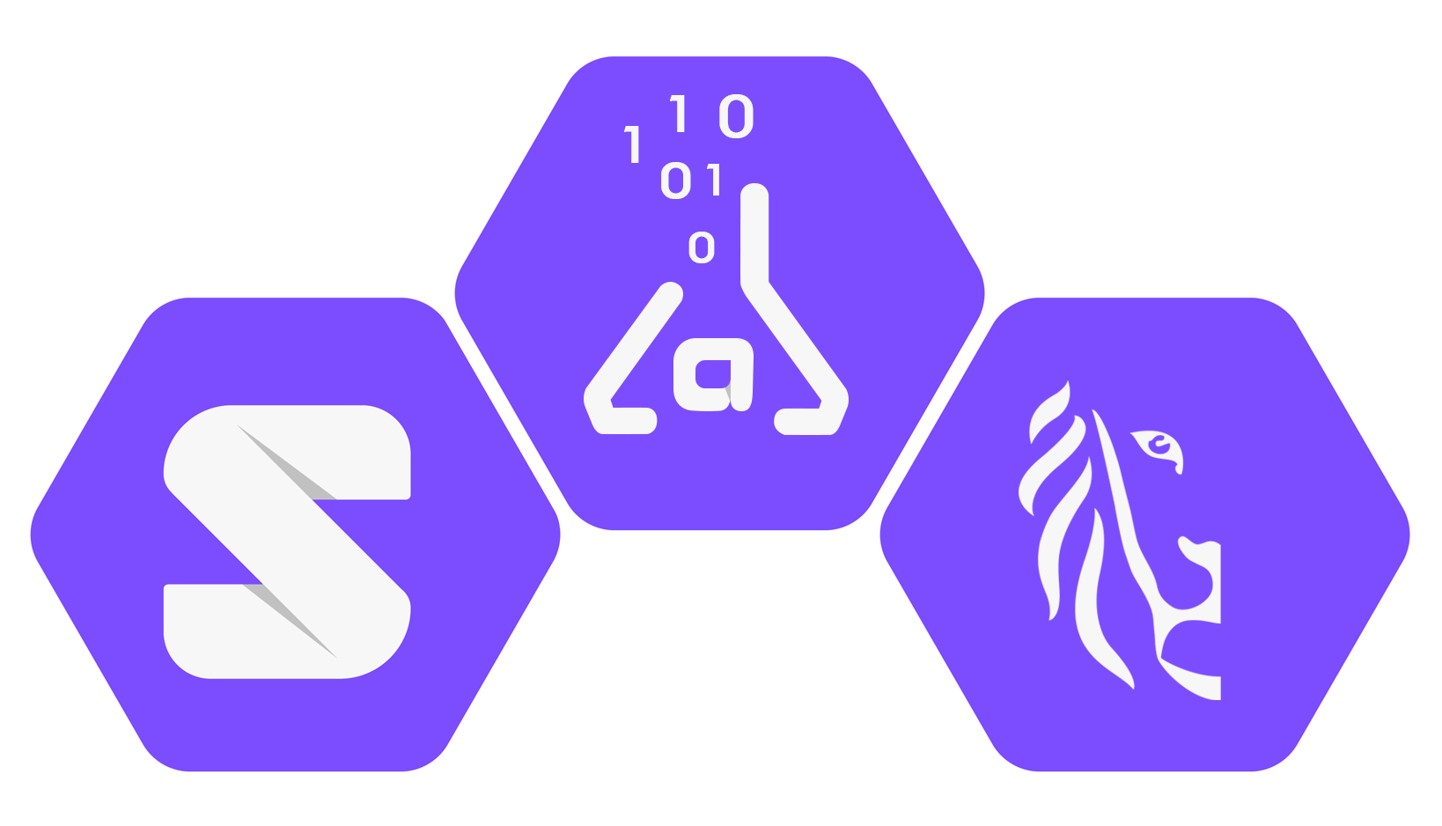




Capturing Requests and Context for ODRL-based Access and Usage Control
Beatriz Esteves
16th Workshop on Ontology Design and Patterns (WOP 2025)
@ 24th International Semantic Web Conference 2025 (ISWC 2025)
November 3rd, 2025
beatriz.esteves@ugent.be | w3id.org/people/besteves

Slide 2
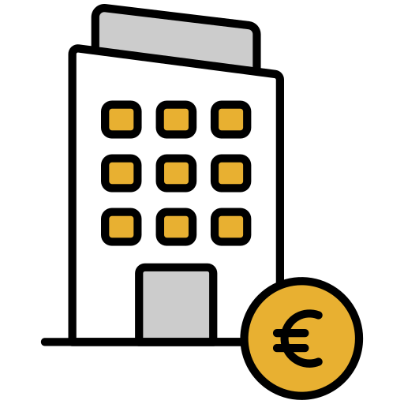


ENTERPRISE
INDIVIDUAL
ENTERPRISE
PEOPLE
INDIVIDUAL
SERVICE

Slide 3
ENTERPRISE
INDIVIDUAL
ENTERPRISE
PEOPLE
INDIVIDUAL
SERVICE

Slide 4
Challenges to Web data exchanges
Human-centric preferences
Broad and narrow permissions
Handle conflicts
Understandability
Handle legal compliance
Automate processes
Derive new insights
Personalise services

Slide 5
How to ensure that the meaning of exchanged data, including its conditions of use,
is preserved and consistently interpreted
by all parties involved in the exchange?

Slide 6

Human-centric preferences
Broad and narrow permissions
Handle conflicts
Understandability
Handle legal compliance
Automate processes
Derive new insights
Personalise services
Standards
Interoperability

Slide 7
Capturing Requests and Context for ODRL-based Access and Usage Control
Why ODRL?
Background on ODRL evaluation & contextual inputs
ODPs for evaluation requests and SotW
ODRL coverage & future challenges
Conclusions

Slide 8
Capturing Requests and Context for ODRL-based Access and Usage Control
Why ODRL?
Background on ODRL evaluation & contextual inputs
ODPs for evaluation requests and SotW
ODRL coverage & future challenges
Conclusions

Slide 9
Open Digital Rights Language (ODRL)
Access
control
Data can only
be accessed by
my GP
Purpose for
access is
service provision
Entity requesting/being requested access
Requested resource(s)
Rules
Permissions
Prohibitions
Constraints
Access for
commercial purposes
Is prohibited
Resource can
only be updated
Email address
can be read by
everyone

Slide 10
Open Digital Rights Language (ODRL)
Usage
control
Data can only be
accessed once
Delete data
after 1 week
Access
control
Data can only
be accessed by
my GP
Purpose for
access is
service provision
Entity requesting/being requested access
Requested resource(s)
Rules
Permissions
Prohibitions
Constraints
Access for
commercial purposes
Is prohibited
Resource can
only be updated
Email address
can be read by
everyone

Slide 11
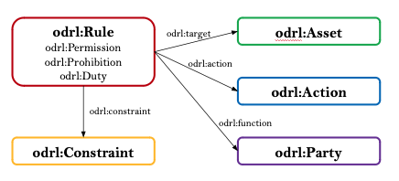

Open Digital Rights Language (ODRL)
Standard for the expression of policies
ODRL Information Model – W3C Recommendation
ODRL Core Vocabulary – W3C Recommendation
Maintained by the W3C ODRL Community Group
Composed by several other specifications
ODRL Implementation Best Practices
ODRL Profile Best Practices
ODRL Formal Semantics [Under development]
ODRL Community Vocabulary [Under development]
Easily extendable through the use of ODRL profiles

Slide 12
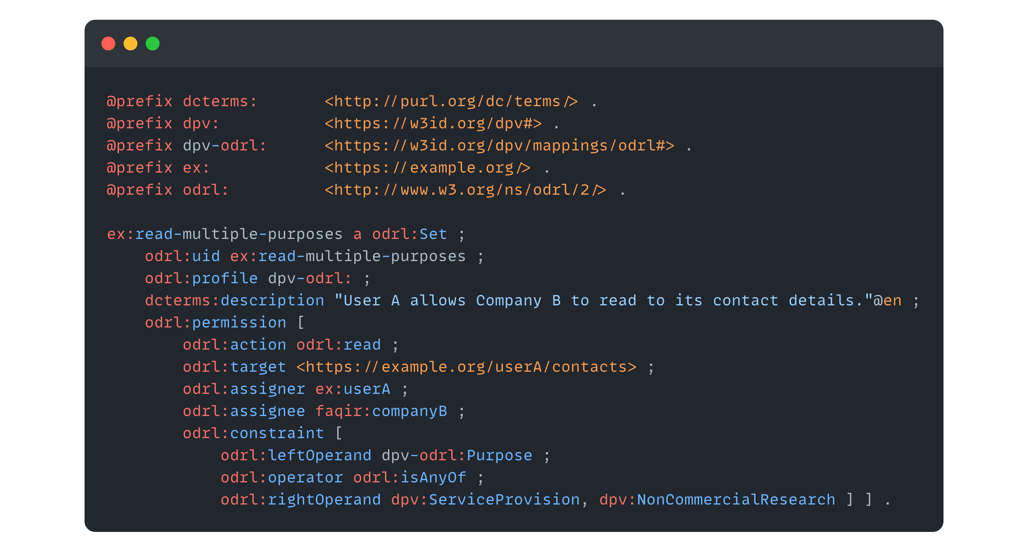
Open Digital Rights Language (ODRL)

Slide 13
Capturing Requests and Context for ODRL-based Access and Usage Control
Why ODRL?
Background on ODRL evaluation & contextual inputs
ODPs for evaluation requests and SotW
ODRL coverage & future challenges
Conclusions

Slide 14
How to interoperably enforce ODRL policies?
Standardised
ODRL Policy
Notes:
Due to non standardization, it would only work for that given project/software.
Even more problematic, others using that software might now know how we came to certain conclusions

Slide 15
How to interoperably enforce ODRL policies?
Standardised
Not Standardised
ODRL Policy
Can I do some action?
Output
Input
ODRL Formal Semantics specification: https://w3c.github.io/odrl/formal-semantics/
Notes:
Due to non standardization, it would only work for that given project/software.
Even more problematic, others using that software might now know how we came to certain conclusions

Slide 16
How to interoperably enforce ODRL policies?
Standardised
Not Standardised
ODRL Policy
Formalising
ODRL evaluator
Output
Input
ODRL Formal Semantics specification: https://w3c.github.io/odrl/formal-semantics/
W. Slabbinck et. al., Interoperable Interpretation and Evaluation of ODRL Policies, The Semantic Web, 2025, pp. 192–209. DOI:10.1007/978-3-031-94578-6_11.
Notes:
Due to non standardization, it would only work for that given project/software.
Even more problematic, others using that software might now know how we came to certain conclusions

Slide 17
ODRL evaluators
ODRE - Open Digital Rights Enforcement (https://doi.org/10.1016/j.cose.2024.104282)
Gaia-X Policy Decision Point (https://wizard.lab.gaia-x.eu/policyStepper)
marketdata.md (https://marketdata.md/)
JavaScript implementation for news information (https://github.com/nitmws/odrl-wprofile-evaltest1/)
ODRL-PAP (https://github.com/wistefan/odrl-pap)
MOSAICrOWN policy engine (https://github.com/mosaicrown/policy-engine)
MYDATA Control Technologies policy engine (https://doi.org/10.5220/0008936003970405)
Prometheus-X ODRL manager (https://github.com/Prometheus-X-association/odrl-manager)
Polival (https://codeberg.org/elbtech/Polival)
ODRL Evaluator Slabbinck et al. 2025 (https://w3id.org/force/evaluator)
ODRL landscape: https://w3c.github.io/odrl/landscape/
Notes:
Due to non standardization, it would only work for that given project/software.
Even more problematic, others using that software might now know how we came to certain conclusions

Slide 18
If they are to behave deterministically & interoperate, ODRL evaluators lack a common vocabulary to represent contextual inputs
Notes:
Due to non standardization, it would only work for that given project/software.
Even more problematic, others using that software might now know how we came to certain conclusions

Slide 19
How to interoperably enforce ODRL policies?
Standardised
Formalising
Inputs
ODRL Policy
ODRL evaluator
Evaluation request
Output
State of the world
Notes:
Due to non standardization, it would only work for that given project/software.
Even more problematic, others using that software might now know how we came to certain conclusions

Slide 20
Related work on input models
[Priebe et al. 2006] context information for the XACML standard
[Mustafa et al. 2014] OJADEAC (Ontology-based Access Control Model for the JADE Platform)
[Kayes et al. 2015] OntCAAC (Ontology-based Context-Aware Access Control) framework
[Brewster et al. 2020] OBAC (Ontology-Based Access Control for FAIR data)
Focused on particular use cases
Focused on access control
Notes:
Due to non standardization, it would only work for that given project/software.
Even more problematic, others using that software might now know how we came to certain conclusions

Slide 21
Capturing Requests and Context for ODRL-based Access and Usage Control
Why ODRL?
Background on ODRL evaluation & contextual inputs
ODPs for evaluation requests and SotW
ODRL coverage & future challenges
Conclusions

Slide 22
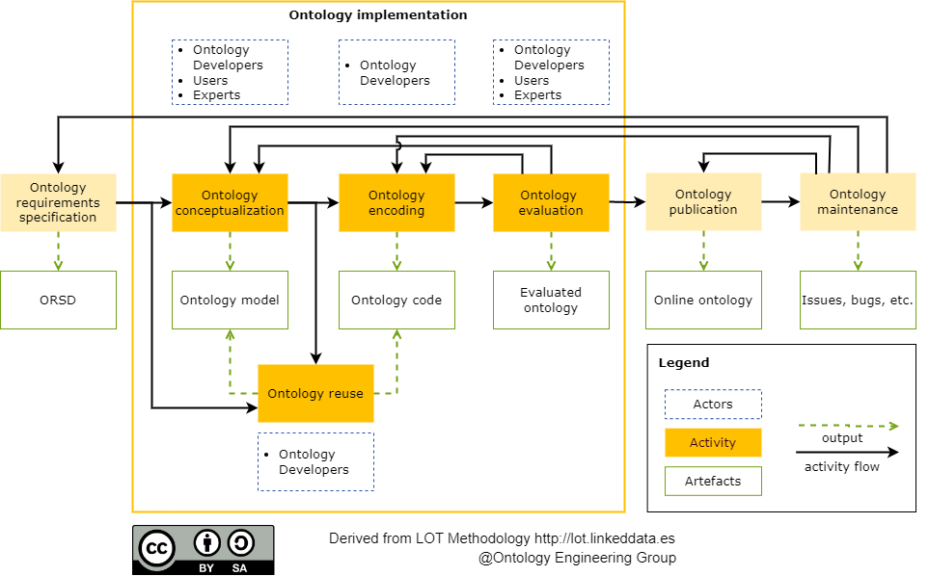
Methodology
Conceptualisation: Chowlk
Encoding: VSCode
Evaluation:
OOPS!
FOOPS!
Publication: w3id.org
Maintenance: GitHub

Slide 23
Company X allows employees to access documents during
weekdays only, from the EU
Notes:
Due to non standardization, it would only work for that given project/software.
Even more problematic, others using that software might now know how we came to certain conclusions

Slide 24
Evaluation requests
Notes:
Due to non standardization, it would only work for that given project/software.
Even more problematic, others using that software might now know how we came to certain conclusions

Slide 25
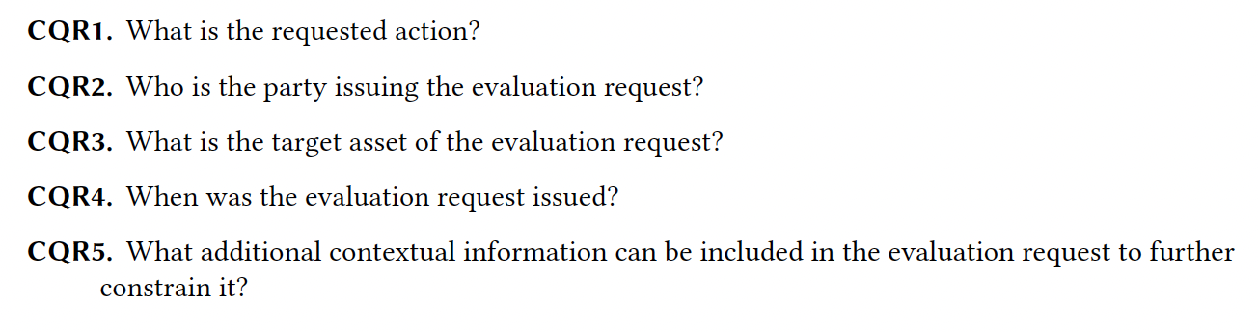
Evaluation requests
Notes:
Due to non standardization, it would only work for that given project/software.
Even more problematic, others using that software might now know how we came to certain conclusions

Slide 26
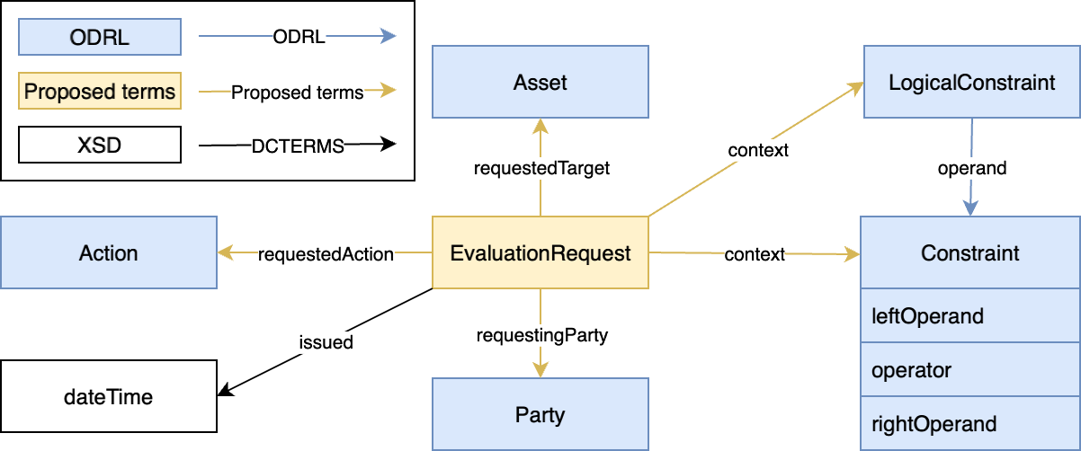
Evaluation request ODP
Notes:
Due to non standardization, it would only work for that given project/software.
Even more problematic, others using that software might now know how we came to certain conclusions

Slide 27
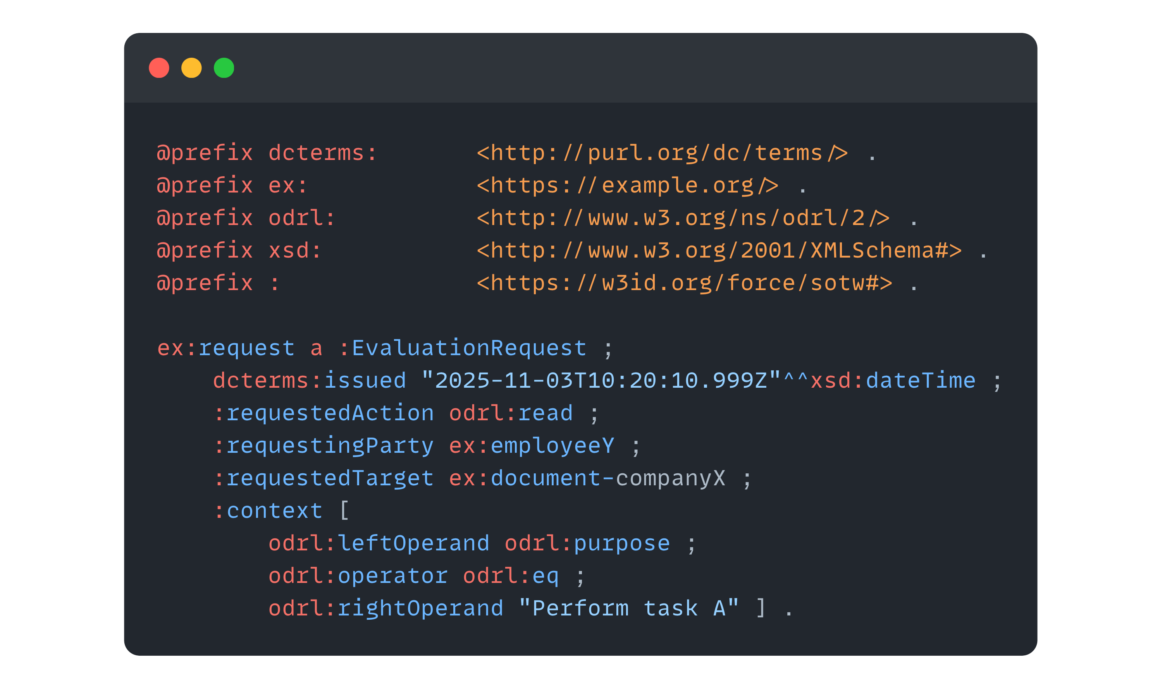
Company X allows employees to access documents during
weekdays only, from the EU
Evaluation request ODP
Notes:
Due to non standardization, it would only work for that given project/software.
Even more problematic, others using that software might now know how we came to certain conclusions

Slide 28
State of the world
Notes:
Due to non standardization, it would only work for that given project/software.
Even more problematic, others using that software might now know how we came to certain conclusions

Slide 29
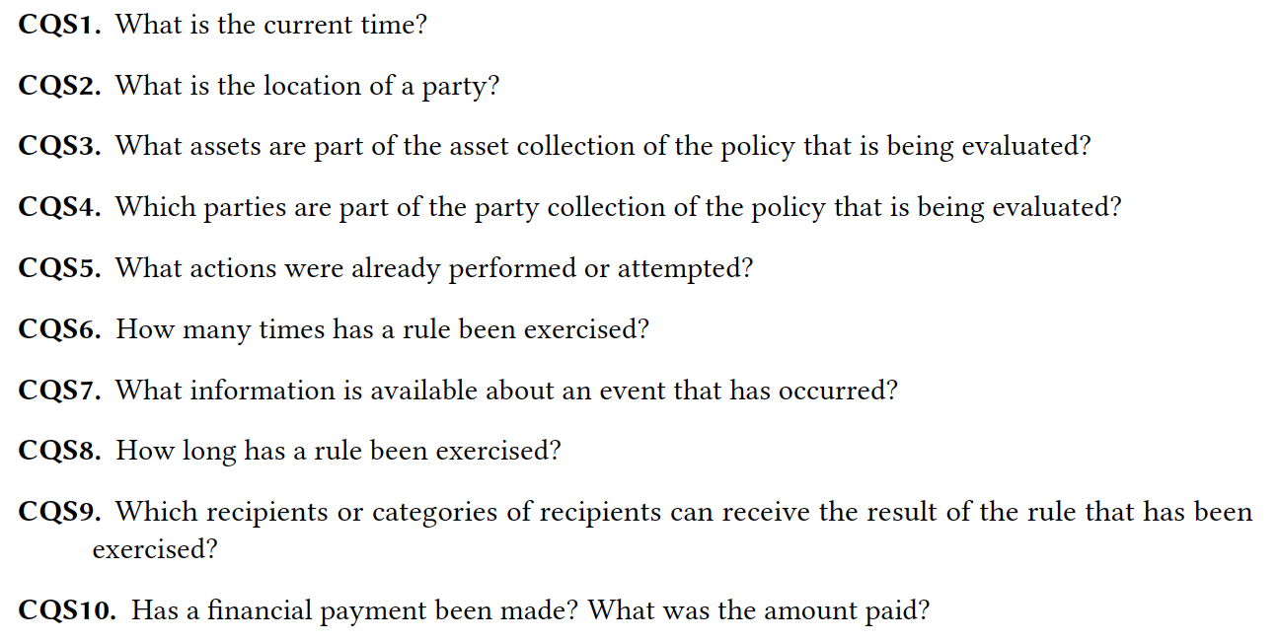
State of the world
Notes:
Due to non standardization, it would only work for that given project/software.
Even more problematic, others using that software might now know how we came to certain conclusions

Slide 30
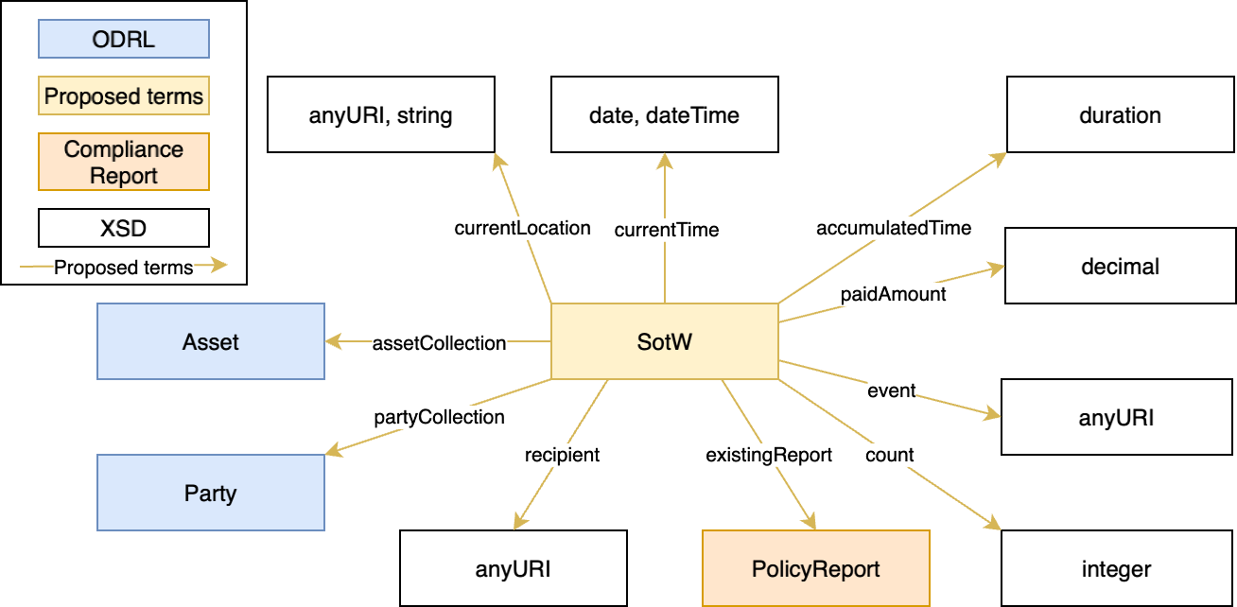
State of the world ODP
Notes:
Due to non standardization, it would only work for that given project/software.
Even more problematic, others using that software might now know how we came to certain conclusions

Slide 31
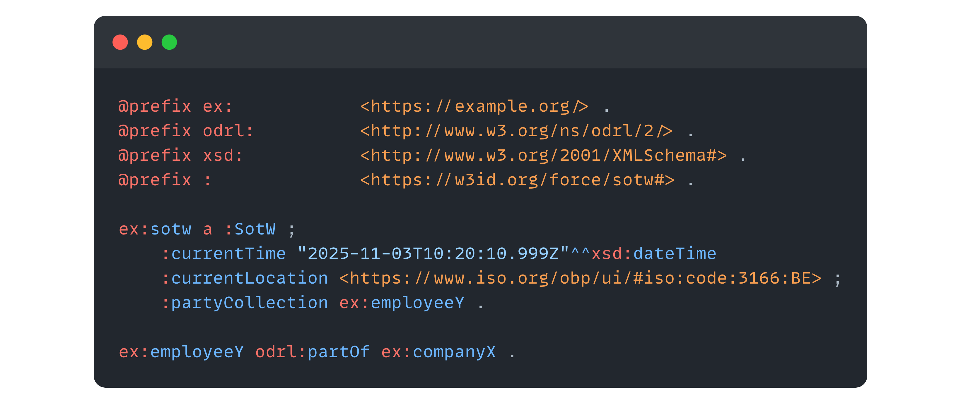
Company X allows employees to access documents during
weekdays only, from the EU
State of the world ODP
Notes:
Due to non standardization, it would only work for that given project/software.
Even more problematic, others using that software might now know how we came to certain conclusions

Slide 32
Capturing Requests and Context for ODRL-based Access and Usage Control
Why ODRL?
Background on ODRL evaluation & contextual inputs
ODPs for evaluation requests and SotW
ODRL coverage & future challenges
Conclusions

Slide 33
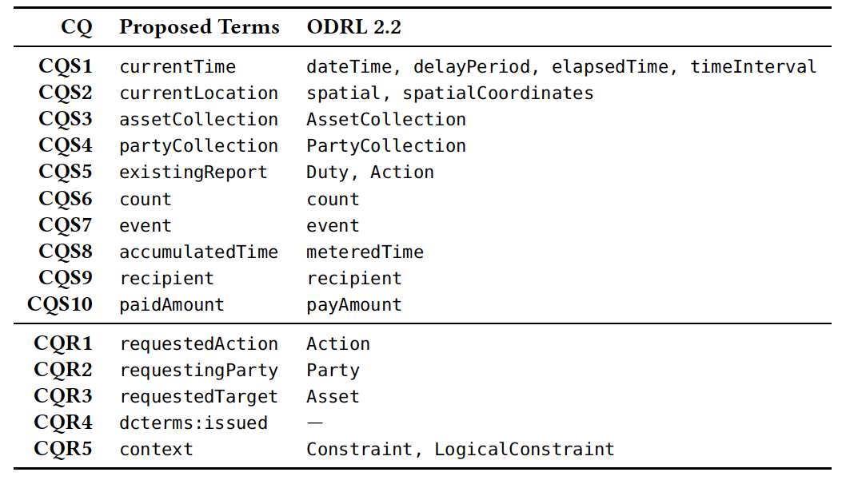
ODRL 2.2 coverage
Notes:
Due to non standardization, it would only work for that given project/software.
Even more problematic, others using that software might now know how we came to certain conclusions

Slide 34
Other challenges
Representing values that may change over time, i.e., dynamic values, related to certain policy constraints, e.g., current time or the GPS coordinates of a party who is moving
Behaviour of the system in case a requested or attempted action is neither permitted nor prohibited by the Policy being evaluated
Introducing a meta-language on top of the ODRL policies to represent variables that are injected on the fly during the evaluation
Adopting ODRL dynamic constraint extension
Open: in case of an open system, anything that is not prohibited is permitted
Closed: in case of a closed system, anything that is not permitted is prohibited
Notes:
Due to non standardization, it would only work for that given project/software.
Even more problematic, others using that software might now know how we came to certain conclusions

Slide 35
Capturing Requests and Context for ODRL-based Access and Usage Control
Why ODRL?
Background on ODRL evaluation & contextual inputs
ODPs for evaluation requests and SotW
ODRL coverage & future challenges
Conclusions

Slide 36
https://w3id.org/force/sotw
Conclusions & future work
The formalisation of fundamental concepts such as the Evaluation Request and the State of the World enables reliable evaluation of ODRL policies, independent of the underlying evaluator architecture or implementation technology.
Presented models are currently part of the ongoing discussions within the W3C ODRL Community Group, particularly in the context of the Formal Semantics document.
Integrate with existing evaluators
Test in real-world use cases (and extend the model)
Notes:
Due to non standardization, it would only work for that given project/software.
Even more problematic, others using that software might now know how we came to certain conclusions

Slide 37
Capturing Requests and Context for ODRL-based Access and Usage Control
Beatriz Esteves, Wout Slabbinck, Yassir Sellami, Andrea Cimmino,
Víctor Rodríguez-Doncel and Ruben Verborgh
16th Workshop on Ontology Design and Patterns (WOP 2025)
@ 24th International Semantic Web Conference 2025 (ISWC 2025)
November 3rd, 2025
beatriz.esteves@ugent.be | w3id.org/people/besteves

